Slide 1


Green Pace
Security Policy Presentation
Developer: Kelsey Wyer

Slide 2

OVERVIEW: DEFENSE IN DEPTH

Slide 3
THREATS MATRIX
Likely | Priority
Low priority | Unlikely
STR-50-CPP
EXP-53-CPP
IDS-00-JAV
ERR-55-CPP
STR-30-CLG
INT-30-CLG
INT-07-CLG
ERR-51-CPP
STR-50-CPP (P18)
EXP-53-CPP (P12)
IDS-00-JAV (P12)
ERR-55-CPP (P9)
STR-30-CLG (P9)
INT-30-CLG (P9)
INT-07-CLG (P8)
ERR-51-CPP (P4)
EXP-40-CLG (P2)
DCL-03-CLG (P1)
DCL-03-CLG
EXP-40-CLG

Slide 4
10 PRINCIPLES
Validate Input Data
Prevent SQL injection
Do not read uninitialized memory
Heed Compiler Warnings
Use only explicitly signed or unsigned char type for numeric values
Architect and Design for Security Policies
Prevent SQL injection
Keep it Simple
Guarantee that storage for strings has sufficient space for character data and the null terminator
Default Deny
Adhere to the Principle of Least Privilege
Sanitize Data Sent to Other Systems
Prevent SQL injection
Practice Defense in Depth
Use Effective Quality Assurance Techniques
Use a static assertion to test the value of a constant expression
Handle all exceptions
Ensure that unsigned integer operations do not wrap
Adopt a Secure Coding Standard
Do not modify constant objects
Honor exception specifications
Do not attempt to modify string literals

Slide 5
CODING STANDARDS
IDS-00-JAV: Prevent SQL Injection.
STR-50-CPP: Guarantee that storage for strings has sufficient space for character data and the null pointer.
EXP-53-CPP: Do not read uninitialized memory.
INT-30-CLG: Ensure that unsigned integer operations do not wrap.
INT-07-CLG: Use only explicitly signed or unsigned char type for numeric values.
ERR-55-CLG: Honor exception specifications.
STR-30-CLG: Do not attempt to modify string literals.
ERR-51-CPP: Handle all exceptions.
DCL-03-CLG Use a static assertion to test the value of a constant expression.
EXP-40-CLG: Do not modify constant objects.
(Carnegie Mellon University, 2020)

Slide 6
ENCRYPTION POLICIES
There are 3 types of encryption that protect data in different states:
Encryption at rest protects data that is being stored.
Encryption at flight protects data being transmitted.
Encryption in use protects data as it is being actively used.
(Lord, 2019)

Slide 7
TRIPLE-A POLICIES
Authentication: Users wishing to gain access must be authenticated via a user login.
Authorization: The level of access a user has is determined when they are added and can only be modified by those who are authorized to do so.
Accounting: Sufficient logs should be kept to monitor things like user accesses, resources used, and actions took.
(Mylonas, 2018)

Slide 8
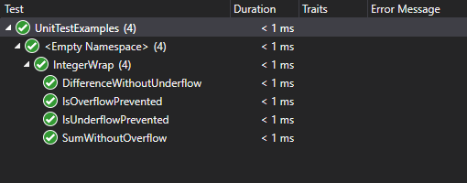
Unit Testing for Integer Wrap Detection

Slide 9
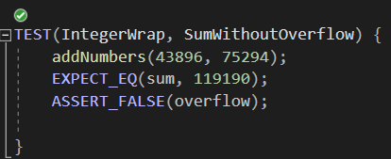
Sum Without Overflow

Slide 10
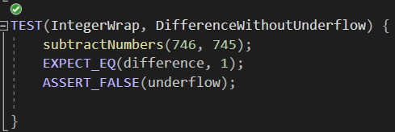
Difference Without Underflow

Slide 11
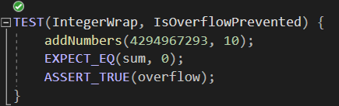
Is Overflow Prevented

Slide 12
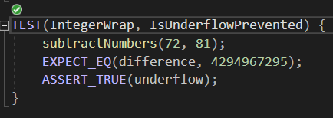
Is Underflow Prevented

Slide 13

AUTOMATION SUMMARY

Slide 14
TOOLS
Stage | Tool/Checker
Design | Static Analysis
Build | Compiler
Respond | SQL Injection Prevention
Monitoring and Detection | Various checkers (proper exception handling, integer wrap, and memory protection etc.)

Slide 15
RISKS AND BENEFITS
Act Now
Less vulnerabilities will need to be addressed later
Over time, leads to more secure coding
Save money on remediation costs
Can cause delays
Can be unnecessarily costly if overdone
Wait
Slight chance for earlier release
Higher chance that vulnerabilities will be missed and end up in the release
Much higher chance of code needing to be reworked
Affects more people and later stages of development
(Federal Trade Commission, 2021)

Slide 16
RECOMMENDATIONS
Default Deny
Principle of least privilege
Pointer safety
Containers
Floating point values

Slide 17
CONCLUSIONS
CTR-50-CPP: Guarantee that container indices and iterators are within the valid range
INT-02-CLG: Understand integer conversion rules
FLP-34-CLG: Ensure that floating-point conversions are within range of the new type
EXP-36-CLG: Do not cast pointers into more strictly aligned pointer types
EXP-39-CLG: Do not access a variable through a pointer of an incompatible type
EXP-08-CLG: Ensure pointer arithmetic is used correctly

Slide 18
REFERENCES
Carnegie Mellon University. (2020). SEI CERT Coding Standards - CERT Secure Coding - Confluence. Confluence. Retrieved December 6, 2021, from https://wiki.sei.cmu.edu/confluence/display/seccode/SEI+CERT+Coding+Standards
Federal Trade Commission. (2021, December 1). Start with Security: A Guide for Business. Retrieved December 12, 2021, from https://www.ftc.gov/tips-advice/business-center/guidance/start-security-guide-business
Lord, N. L. (2019, July 15). Data Protection: Data In transit vs. Data At Rest. Digital Guardian. Retrieved December 5, 2021, from https://digitalguardian.com/blog/data-protection-data-in-transit-vs-data-at-rest
Mylonas, L. M. (2018, November 27). What is AAA security? An introduction to authentication, authorisation and accounting. Codebots. Retrieved December 12, 2021, from https://codebots.com/application-security/aaa-security-an-introduction-to-authentication- authorisation-accounting

